Slide 1

Educational Technologies & Lesson Plans
By Ed Marrs

Slide 2
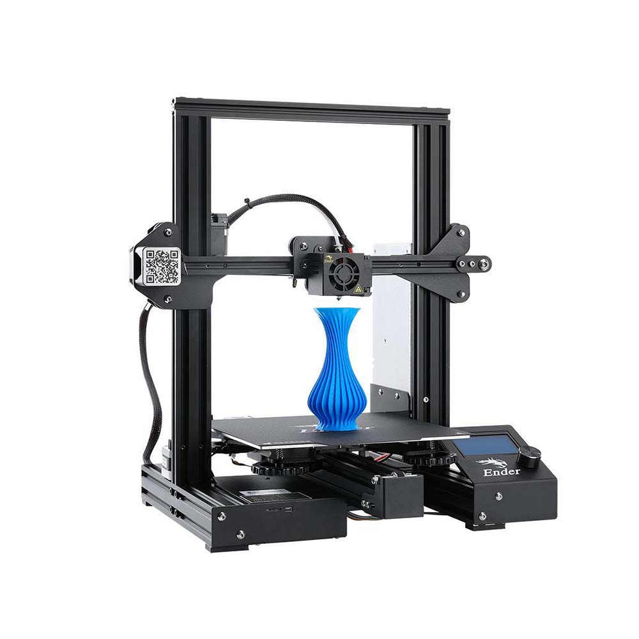
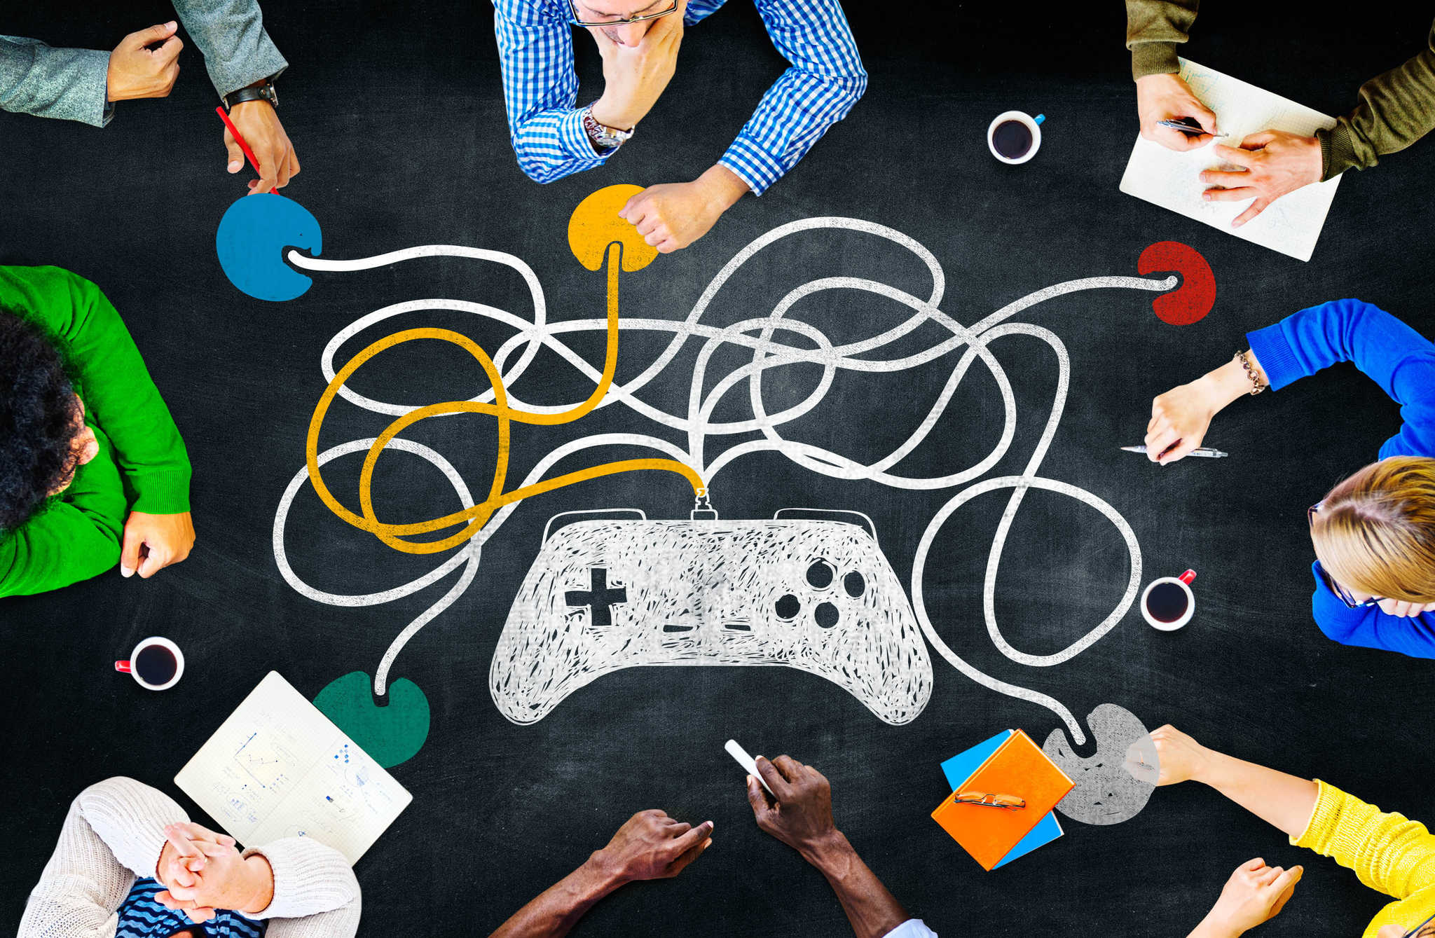
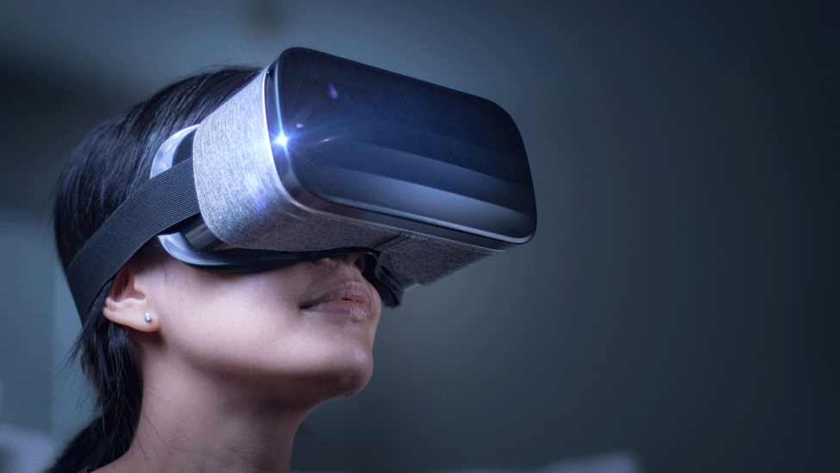
What I Researched
Researched 3 Technologies currently at the forefront of Technology Education
3D Modeling/Printing
VR
Games in Education

Slide 3
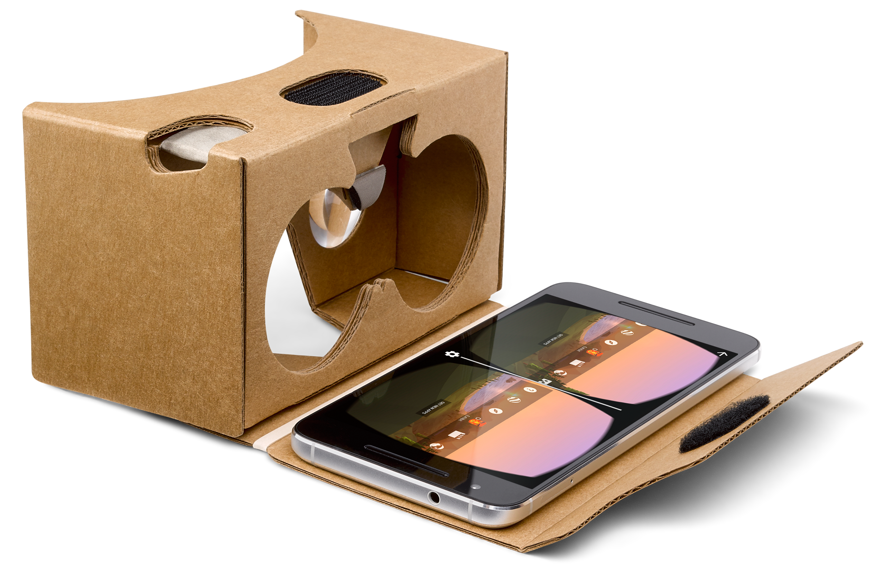
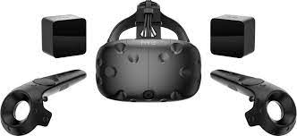
VR Tools
Standalone
Z-Space
Oculus Quest
Mobile
Google Cardboard
Daydream View
PC Powered
HTC Vive
Valve Index

Slide 4
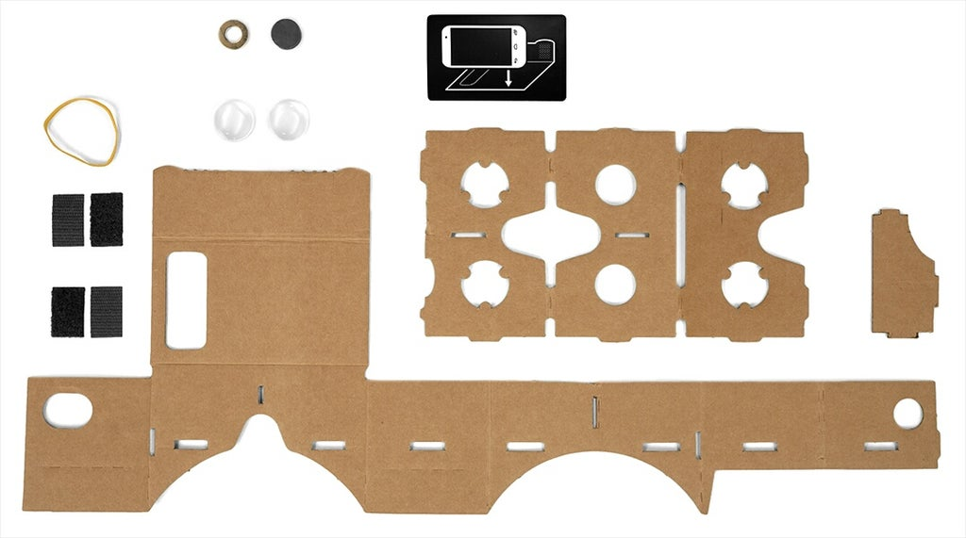
VR Lesson Plan
Objective: To Learn the basics of developing a VR app and uploading it to our phones:
Required Tools:
Google Cardboard + Android Phone
Unity
Google VR SDK for Unity
Do Now: Have Students pick up a Google Cardboard from the Front Desk and use the attached instructions to build it

Slide 5
Introduce the Technologies we will be using today. Go over the basics of Unity. Show Students the application we will be using today (Unity VR Demo Application)
Show students what application to open to get to Unity on the computers and give them a brief overview of the basic features and how to navigate.
Allow them to explore and play with the settings available in Unity for 5 minutes.
Have students upload the Unity VR Demo Application to their device.
Have Students Press “Build & Run” on the application, and upload it to the device. The application should launch on the android phone. Allow Students to Play with the demo app and troubleshoot any potential issues going on.
Show students how to change & modify the app, do this for the rest of class
Create a new Project in Unity and have students import the Android VR SDK + the demo application.
Show students how to place objects within the Unity Scene. Have Students use one of the default unity assets and place it in the scene view. Allow them to rebuild the application and see how it has changed.
Show students how they can modify the asset by changing the texture, size, lighting and physics. Allow them to experiment with changing and adding assets for the remainder of class, and help students who are having difficulty troubleshoot.

Slide 6
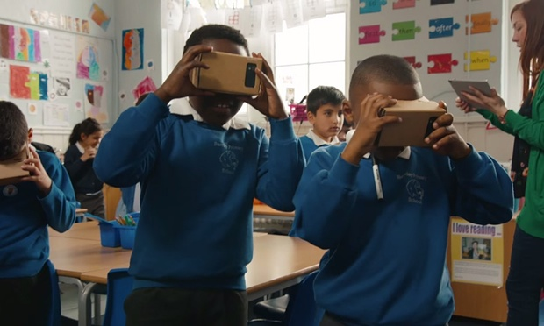
Closing: Go over the technologies we used today. Review the basic features of unity and how to open/run projects. Review how we made changes to our VR application.
For Next Class: Introduce programming within Unity and how it can be used for interactable VR spaces.

Slide 7
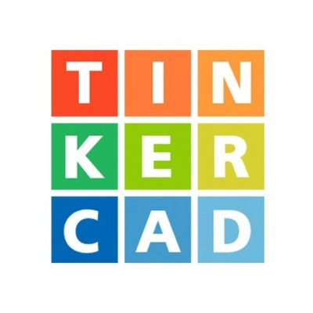
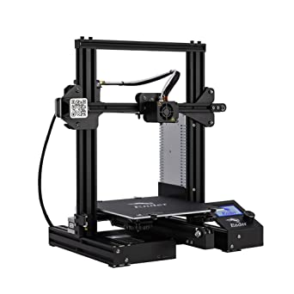
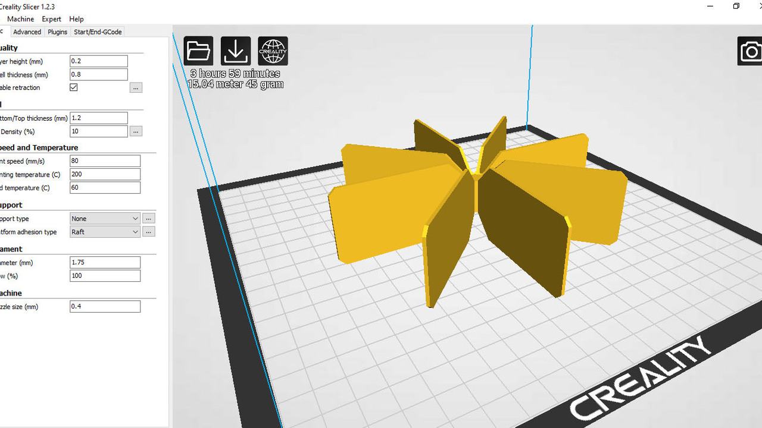
3D Modeling & 3D Printing Tools
Modeling Software
TinkerCAD
Blender
Slicer
Creality 3D Slicer
Printer
Variety of Models and Features depending on Budget

Slide 8
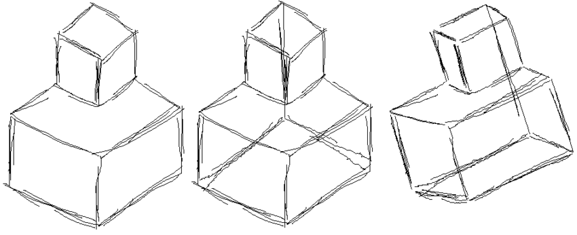
3D Modeling Lesson Plan
Objective: To learn how to use basic 3D Modeling software, and how we can print those models, and the limitations of doing so.
Required Tools:
TinkerCad
Do Now: Have students come up with ideas of things they may want to try to 3d Model. Have them sketch out these ideas on paper.

Slide 9
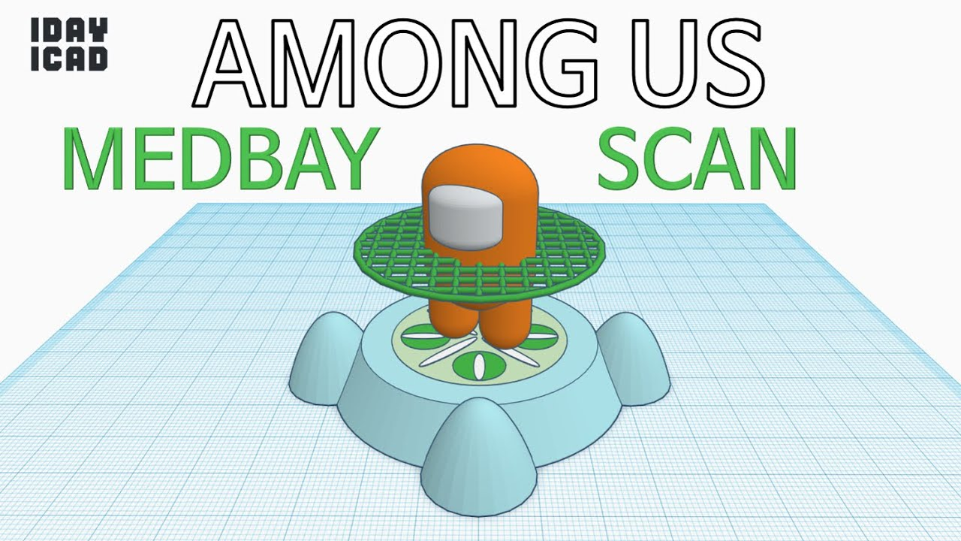
Introduce Tinkercad to the students and present that we will be using it for modeling. Have students join the tinkercad classroom. For 10 minutes, go over the basics of 3d modeling, how to change the camera angle & how to place & modify objects within the Tinkercad space.
For 10 Minutes, allow students to begin experimenting with Tinkercad and allow them to build models to become accustomed to the software.
Introduce the Students to the 3D printer, in operation. Explain to them the challenges that arise when bringing a 3D model into the physical world via a printer. Explain some of the physical rules that models need to adhere to in order to have them print properly (Size, Supports, Rafts, Ect.) (10 Minutes)
Allow Students to return to their desks, and modify or start a new model that adheres to these rules. Help Troubleshoot any issues (10 Minutes).

Slide 10
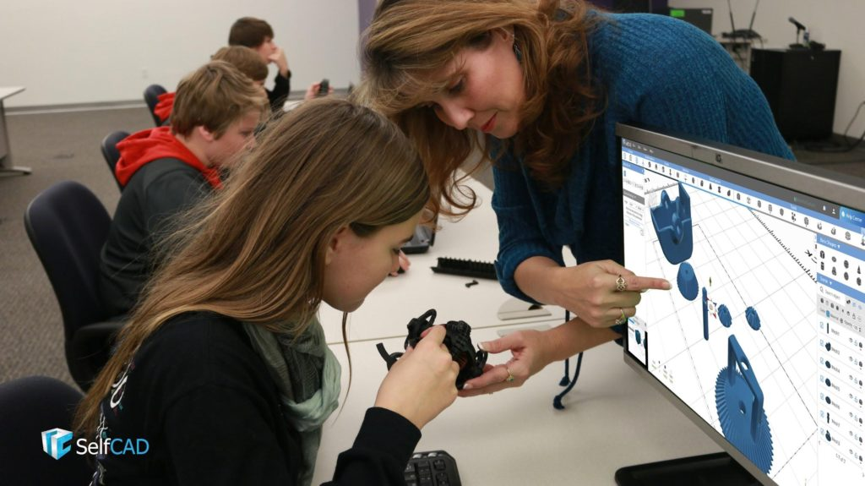
Closing: Review the basic controls of TinkerCad, and some of the rules our models need to adhere to in order to print out properly.
For Next Class: Allow students to work on their models more, and introduce slicer programs as a way to convert our 3D models into printing instructions.

Slide 11
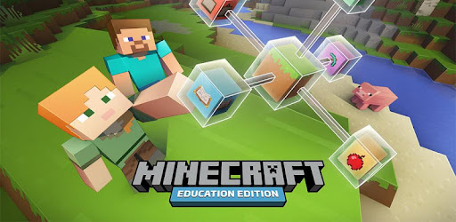

Games in Education Tools
Game Software
Minecraft Education Edition
Minecraft PI Edition
Roblox
Game Development Tools
Unity
Game Maker Studio 2
Unreal Engine 5

Slide 12
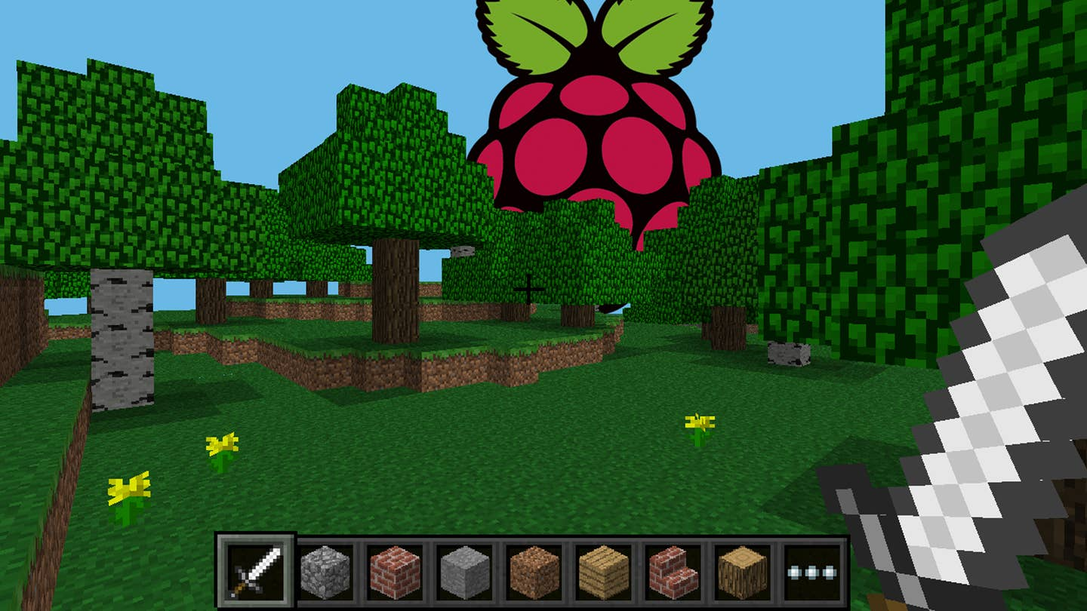
Games in Education Lesson Plan
Objective: To Teach students about Python Code by use of Minecraft Pi Edition.
Required Tools:
Raspberry Pi + Keyboard/Mouse/Power
Minecraft Pi Edition (Free)
Do Now: Have students come up with ideas of modifications they might want to try to make in Minecraft.

Slide 13
Introduce the Raspberry Pi to students. Have them turn it on, and figure out how to navigate Rasbian (Raspberry Pi’s Linux-Based OS). Allow them to play around with it for 5-10 minutes.
Introduce the students to Minecraft Pi Edition. Stress to them that they need to stay on task while working with it, as its easy to get distracted when working with a game. Let them explore the differences & changes of Minecraft Pi from the Retail Edition for 5 minutes.
Introduce students to the first Minecraft Python program. Show students how to use python to place a block at the players’ position. Allow them to experiment with the function’s parameters to see how altering it can change the position of the block, and the type of block. (5 Minutes)
Challenge students to try and make a 5x5 smiley face or similar drawing using the SetBlock function. Challenge students who finish early to make a more complex image at 10x10 or 15x15. (10 Minutes)
Introduce looping to students. Show them how to set 3 blocks next to each other by incrementing the blocks. Challenge students to draw the smiley face again but by using a loop instead. (10 minutes)

Slide 14
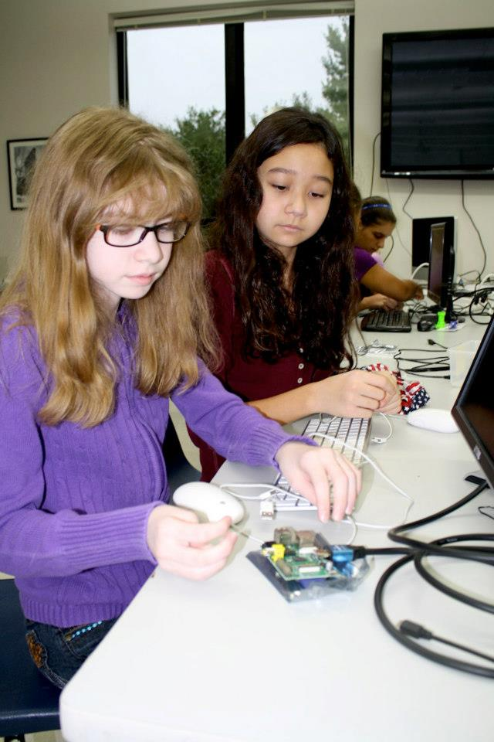
Closing: Review the basics of the raspberry pi and the Python Code we learned. Review the key terms learned.
For Next Class: Allow students to experiment with loops more, and have them use it to create an “Infinitely Spawning Pathway” under their feet.

Slide 15
Resources Found
VR
https://developers.google.com/cardboard/develop/unity/quickstart
https://developers.google.com/vr/develop/unity/get-started-android
https://learn.unity.com/search?k=%5B%22tag%3A5900b95a090915001e654b47%22%5D-More Lesson Ideas for later classes
3D Modeling & Printing
https://www.tinkercad.com/learn
https://www.tinkercad.com/teach
https://www.tinkercad.com/lessonplans
https://3dprintingindustry.com/3d-printing-basics-free-beginners-guide/

Slide 16
Resources Found
Games in Education
https://www.raspberry-pi-geek.com/Archive/2014/03/Learning-to-program-with-Minecraft
https://pimylifeup.com/minecraft-pi-edition-api-reference/
https://www.reddit.com/r/gamemaker/comments/ng7sao/what_is_the_best_way_for_learning_gamemaker/
https://education.minecraft.net/en-us/resources/explore-lessons

Slide 17
Questions?

